Slide 1
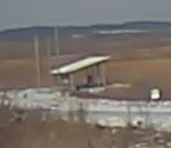
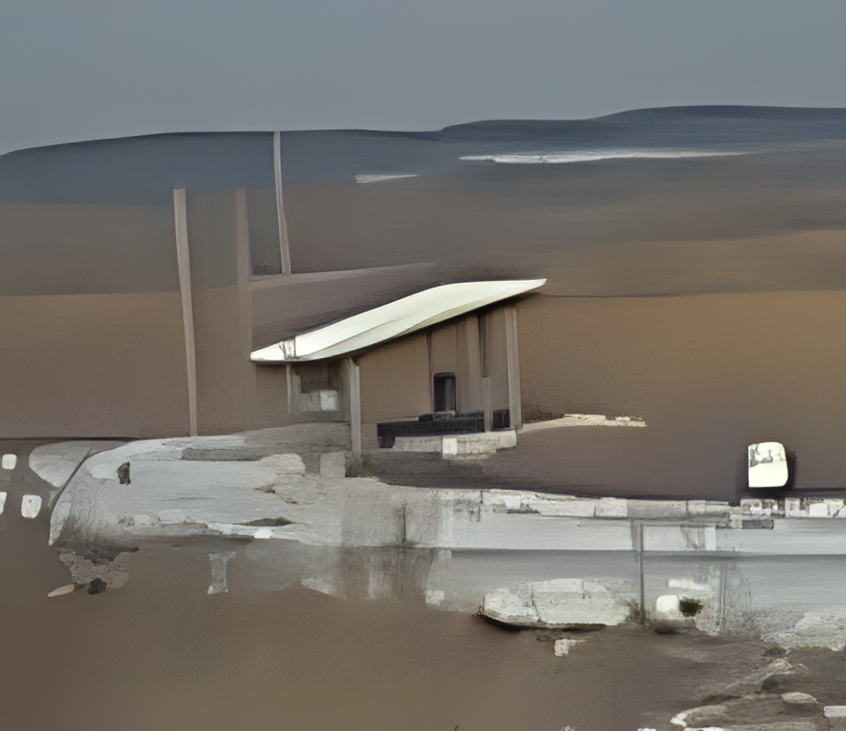

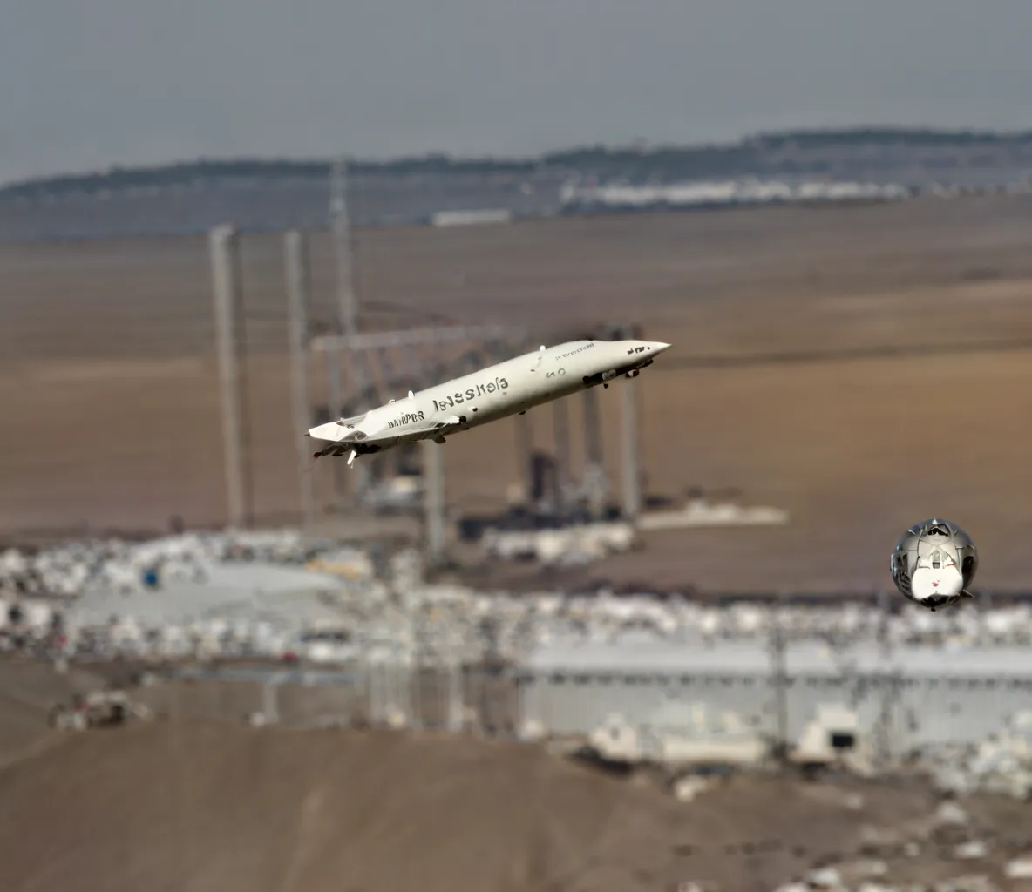
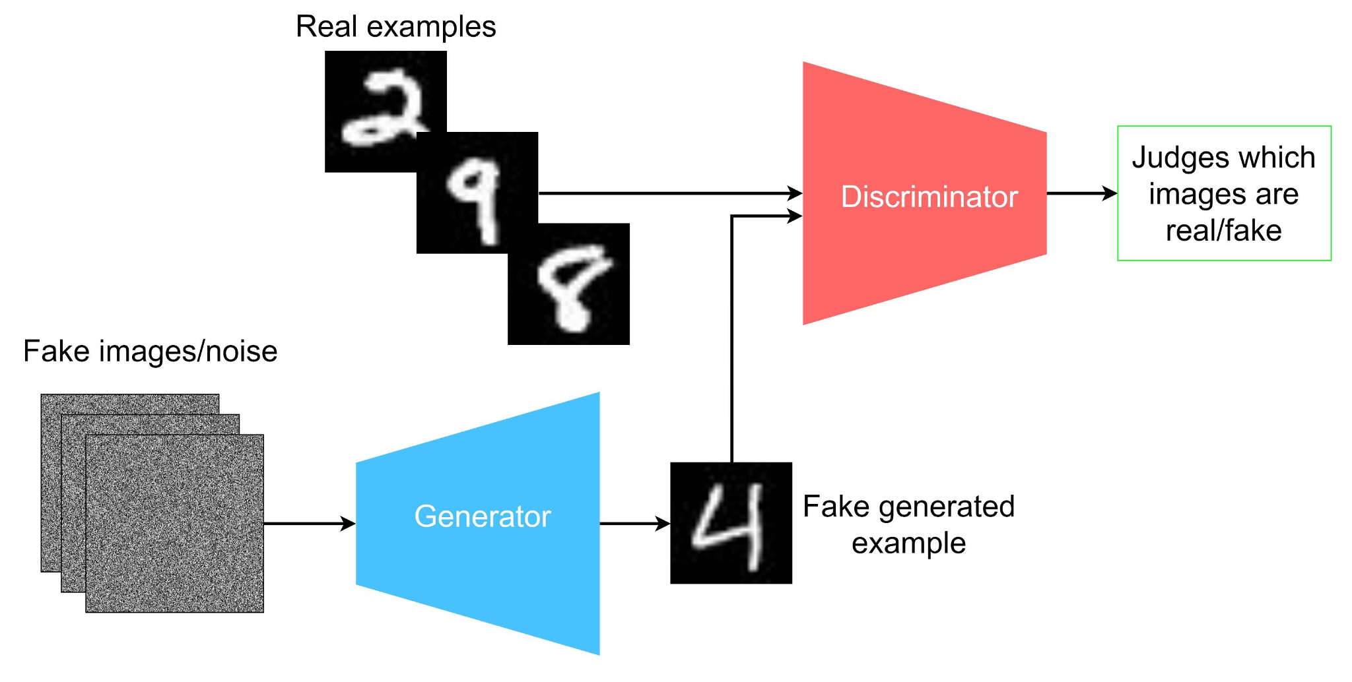
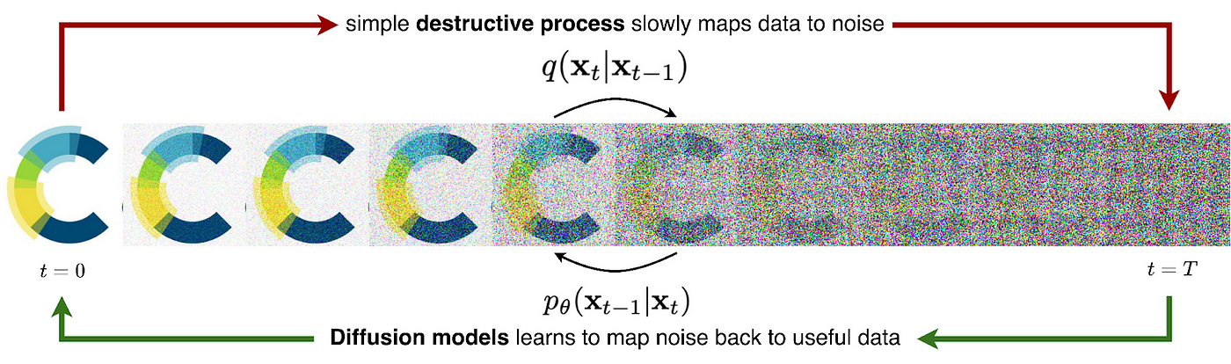




Exploration of Super Resolution Image Enhancement
Alexander Nishio, Data Science, Purdue University
Seongha Park, Mathematics and Computer Science, Argonne National Laboratory
Introduction
Results
Super-resolution is a image processing technique used to improve images through enhancing the resolution of a low-quality image. It plays a critical role in various fields for restoring old images, analyzing distant satellite images, and analyzing microscopic organisms in medical diagnoses. As technological and scientific advancements continue to improve, there is an increase in demand for image enhancement tools to create greater discoveries. This project serves to explore different types of super-resolution models and understand the feasibility of deploying such models into laboratory systems.
Below are the results highlighting the advantages SUPIR has over Real-ESRGAN:
Advantages of Real-ESRGAN:
Small model (<1 GB)
Requires <1 GB of VRAM
Runs on CPU as well
Fast compute time
Deployable on Edge
Advantages of SUPIR:
The image enhancement is much more powerful compared to Real-ESRGAN
Disadvantages of SUPIR:
Extremely large model (30-40 GB)
Requires 4-10 GB of VRAM
Requires GPU
Inefficient for large batch sizes
Poor results if no text provided
Poor at rendering text
Background
Disadvantages of Real-ESRGAN
Poor results if the image quality is too small
Image enhancement is not very apparent
I explored two models in this project: Real-ESRGAN and SUPIR, which are two of the best super resolution models in their own domain. Below is a general overview of the two models:
Real-ESRGAN (GAN Model)
A Generator and a Discriminator competes against each other in performance
Generator creates fake images to fool the Discriminator
Discriminator tries to guess the real image between the generated image and the actual image
Runs into issues if the Discriminator or the Generator is not effective enough
SUPIR (Diffusion Model)
A type of generator
Adds noise to the original image and slowly denoises the image to learn complex patterns
Adjusts loss to make sure the image is as high quality as possible
There is an attached text prompt option to help guide the model to the correct output
Can plug in a Natural Language Processing Model for nice results
Extremely computationally expensive, and the model is very large
Input: 220x190
Real-ESRGAN 4x
SUPIR with prompt
SUPIR without prompt
~10 seconds
~70 seconds
~70 seconds
Figure 3: Comparison of Results between the Two Models
Conclusion
We explored the advantages and disadvantages of Real-ESRGAN and SUPIR and determined that it is difficult to deploy super resolution models into the laboratory systems, since current technology does not provide a proper balance between number of computational resources, time, and quality generated.
Future Goals:
Finish the deployment of models onto Lab Sage Nodes
Implement a Slack Bot
Create a Web Interface / Gradio for more customization
Figure 1: Diagram of a Generative Adversial Network (GAN) Model
Figure 2: Diagram of a Diffusion Model
This research was supported in part by the U.S. Department of Energy (DOE), Omni Technology Alliance Internship Program. The program is championed by the DOE’s Office of Chief Information Officer (OCIO) and represents a partnership with the leadership of the Office of Economic Impact and Diversity, the Office of Science, the Office of Nuclear Energy, and the National Nuclear Security Agency. The program is administered by the Oak Ridge Institute for Science and Education.

